Slide 1

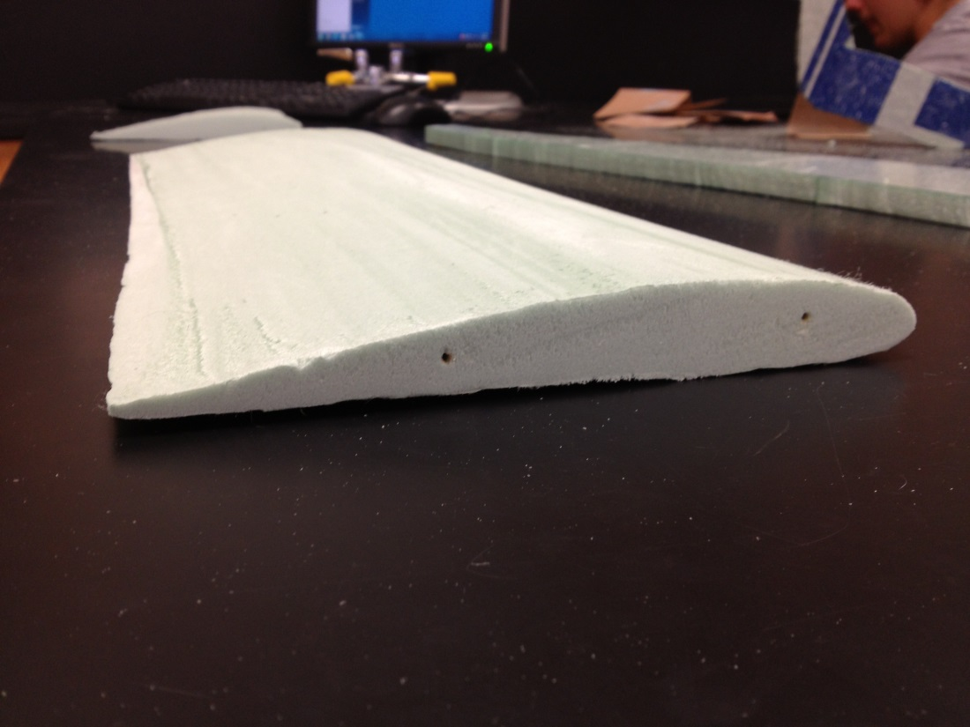
PLTW
Aerospace Engineering
Taught by Mr. Sturge
Jacob McCullum

Slide 2



Course Overview
The class consists of hands-on group projects and theory behind aircraft design
Each project applies the design process, uses various forms of CAD and other advanced design technology, and shows the practicality of the theory learned

Slide 3
Projects and Concepts
Paper airplane testing (Design process review)
Glider design and testing (Center of gravity, center of pressure, forces of flight)
Airfoil design and testing (Parts of an airfoil, forces of flight)
Flight Simulator (Aircraft functionality, instrument functions and capabilities)
Materials Testing (Modulus of elasticity, deflection)
Model RC plane research, design, and test (Review of all previous concepts)

Slide 4
Paper Airplane Project
The class was asked to design two ideal paper airplanes: one that stayed in the air the longest and the other that flew the farthest
Good review of the engineering design process

Slide 5
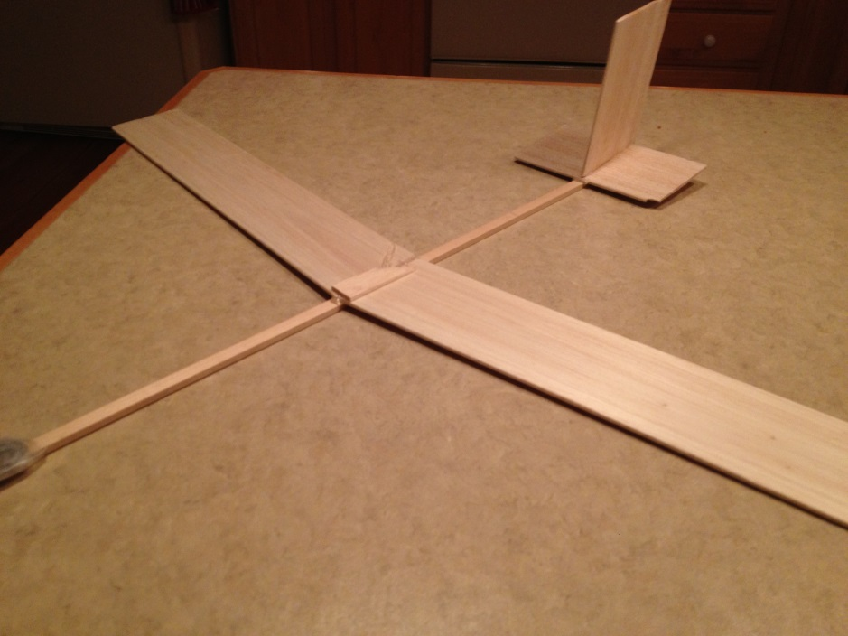
Glider Project
Designed a glider using a program, then constructed based off of design
Completed several tests to learn about aircraft stability during flight

Slide 6
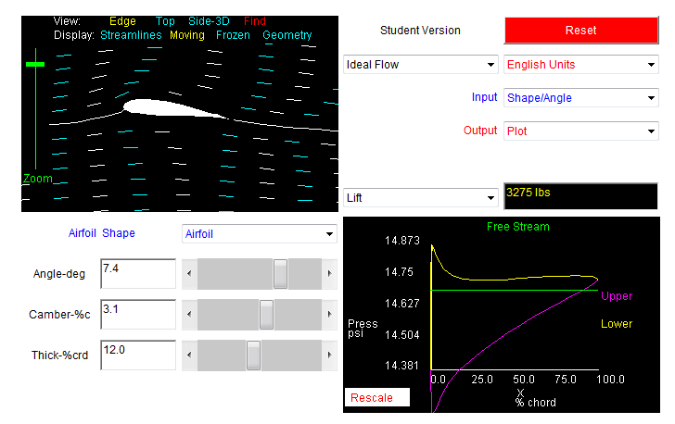
Airfoil Design/Testing
Constructed an airfoil out of foam which was designed online with help from excel
A rig was designed and constructed to measure the amount of lift that the airfoil produced

Slide 7
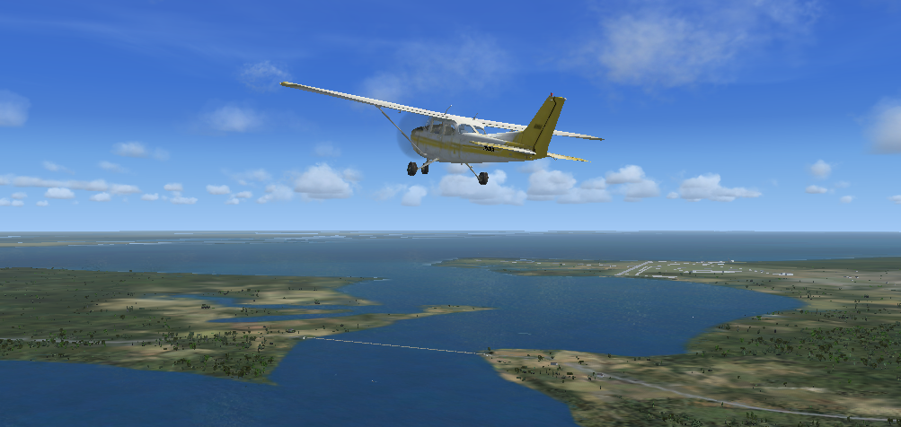
Flight Simulator
We used Microsoft Flight Simulator X to see how aircraft operate during turns, stalls, etc.

Slide 8
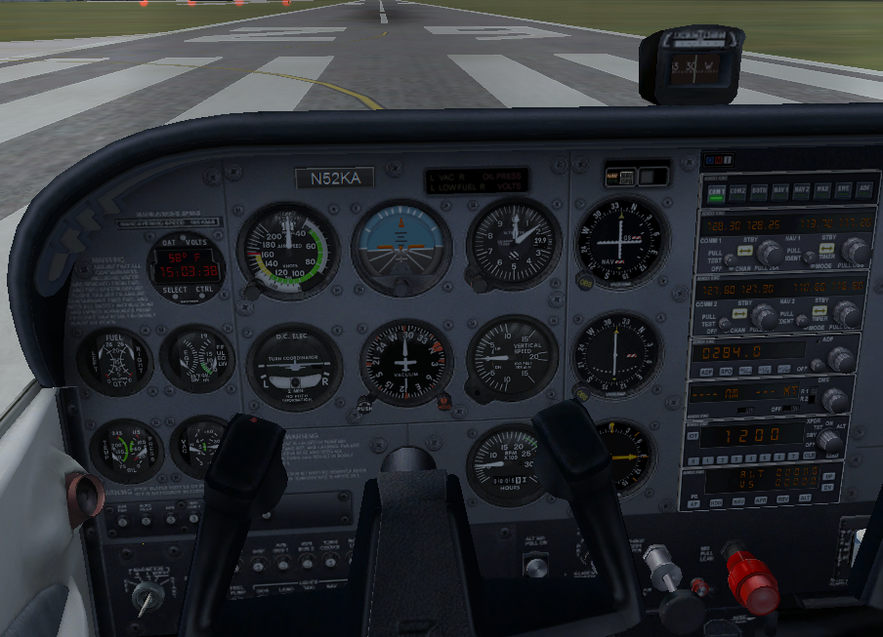
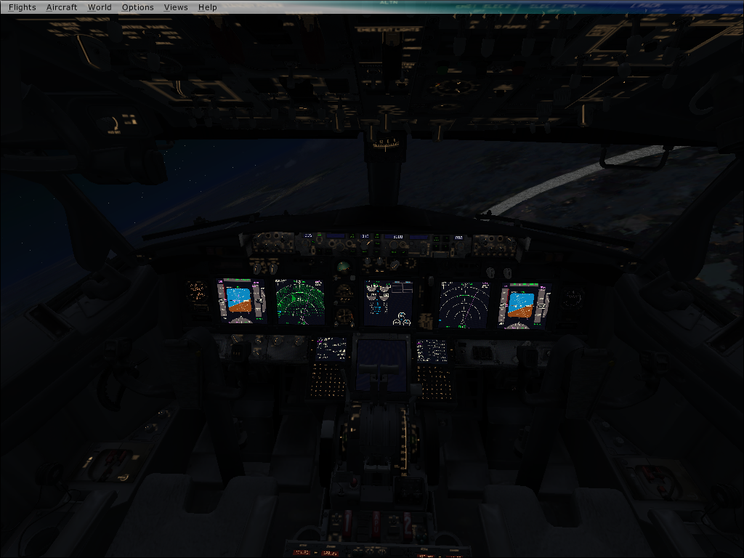
The class learned how to use various instruments for navigation and control of a small airplane
Also discussed were gyroscopes and pitot systems which are used in aircraft instruments

Slide 9
Materials Testing
Applied a force to 3 different materials to find deflection and modulus of elasticity
Repeated the process after coating with fiberglass

Slide 10
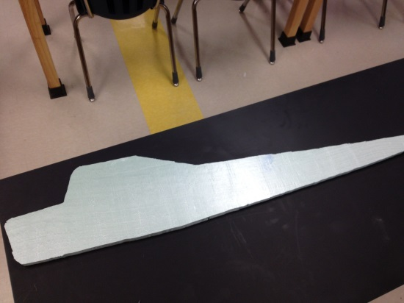
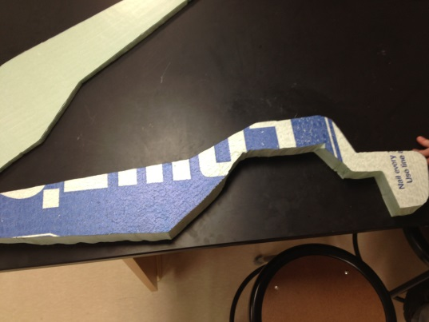
RC Model Plane Design Project
This is a long term project that we work on in three person teams a few days per week.
The purpose of this project is to simulate a real world design problem. The project requires us to keep a daily journal and has four parts:

Slide 11
1
Research existing aircraft design
2
Design scaled-down version of aircraft
3
Construct a fully functional model of the aircraft
4
Test aircraft for stability and strength in flight

Slide 12
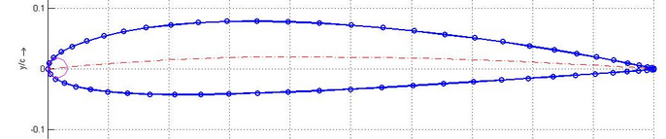
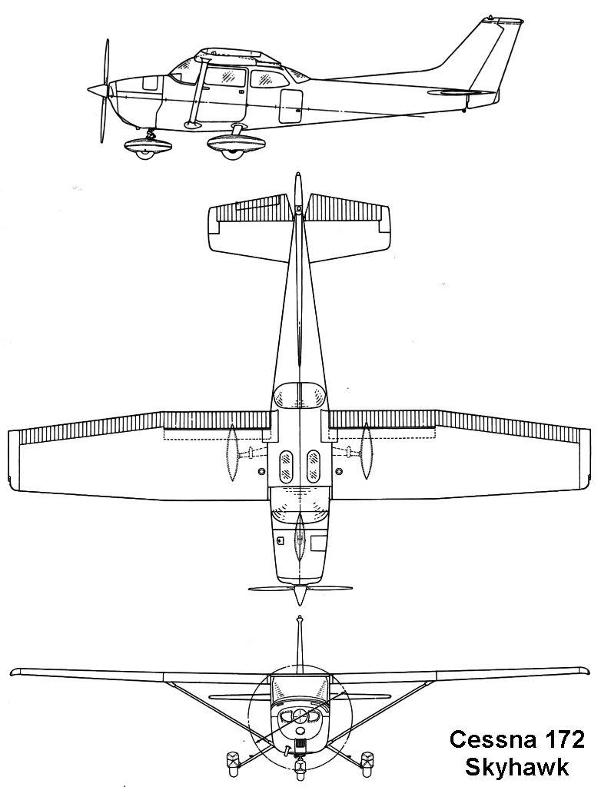
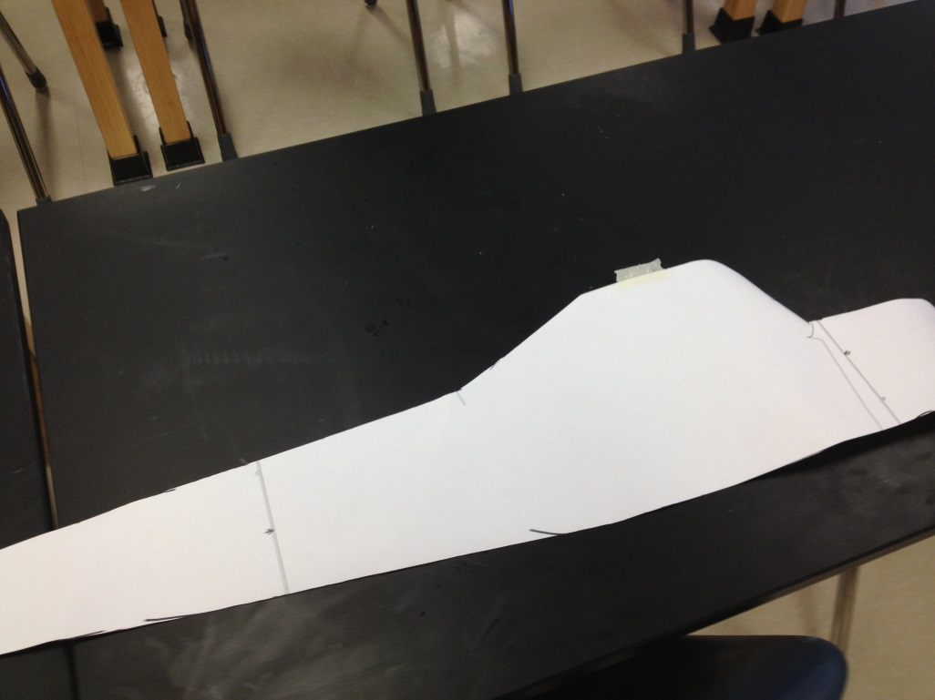

Slide 13
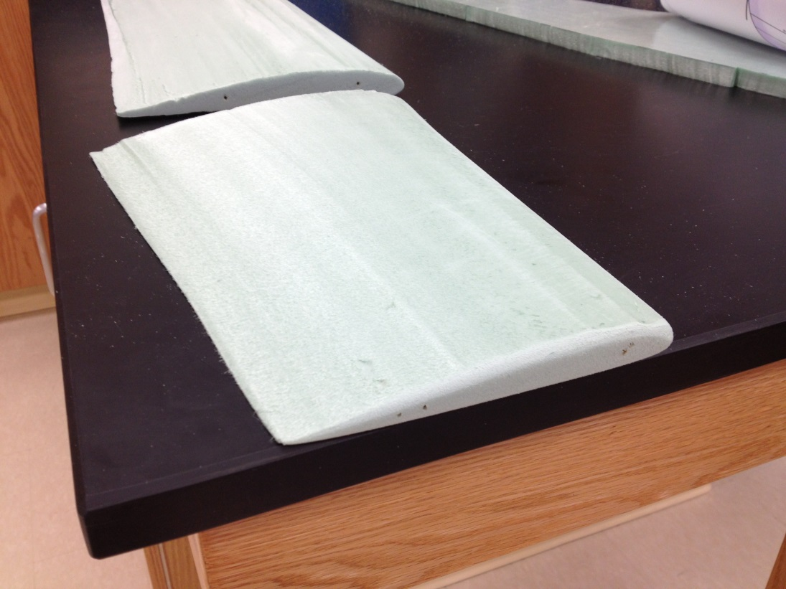
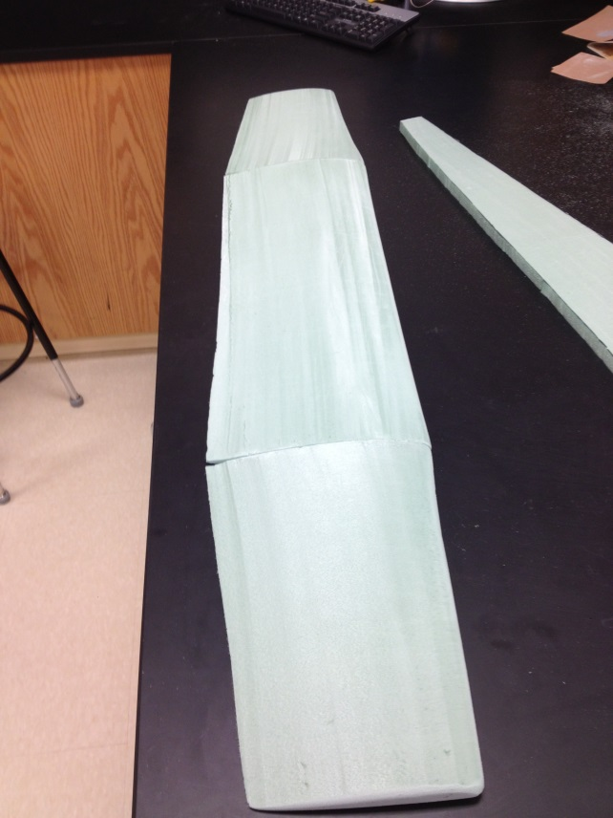
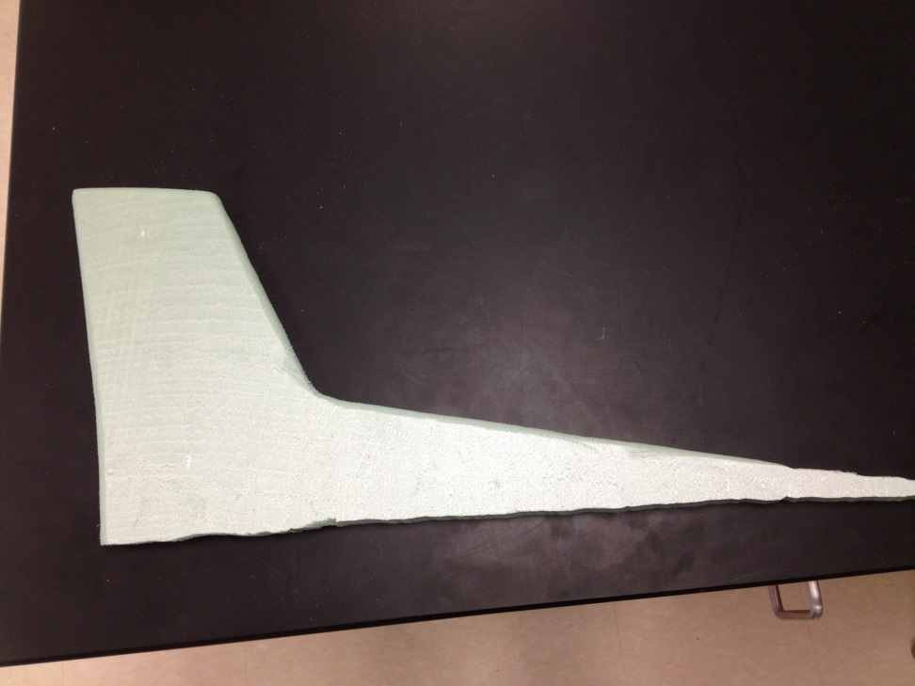

Slide 14
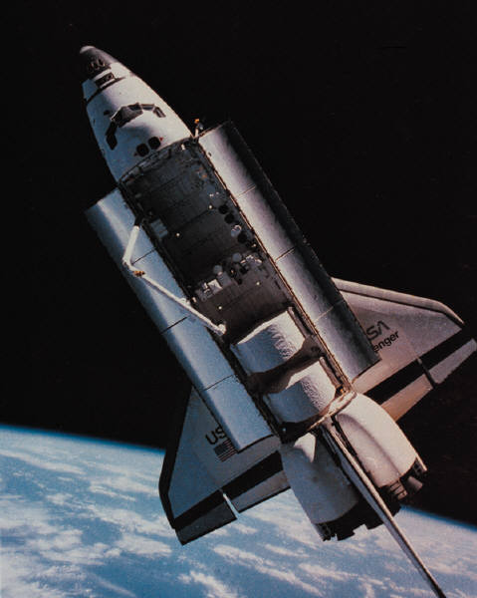
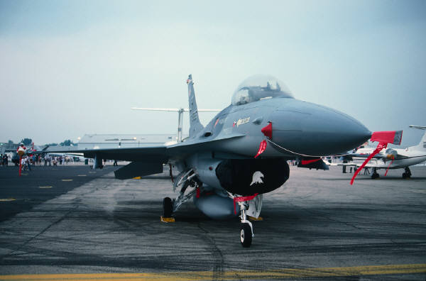
Conclusion
THIS CLASS IS FUN!
Skills I have gained from taking this course so far:
  Leadership
  Hands-on working skills
  Communication

Slide 15
Thank You!

